Slide 1
Exception Handling

Slide 2
Mr. M.R. Solanki
Sr. Lecturer, Information Technology,
manish_ratilal2002@yahoo.com
SBMP

Slide 3
Learning Outcomes
Students will be able to:
Define an exception with suitable example
Use try, catch, throw, throws and finally key words appropriately
Distinguish between checked and unchecked exceptions in Java
Write user defined exception class

Slide 4
Definition of exception

Slide 5
Exception
An exception is an abnormal condition that arises in a code sequence at run time. (run time error)
A Java exception is an object that describes an exceptional condition that has occurred in a piece of code.
When an exceptional condition arises, an object representing that exception is created and thrown in the method that caused the error.
That method may choose to handle the exception itself, or pass it on. Either way, at some point, the exception is caught and processed.

Slide 6
Exception
Exceptions can be generated by the Java run-time system, or they can be manually generated by your code.
Exceptions thrown by Java relate to fundamental errors that violate the rules of the Java language or the constraints of the Java execution environment.
Manually generated exceptions are typically used to report some error condition to the caller of a method.
Java exception handling is managed via five keywords: try, catch, throw, throws, and finally.

Slide 7
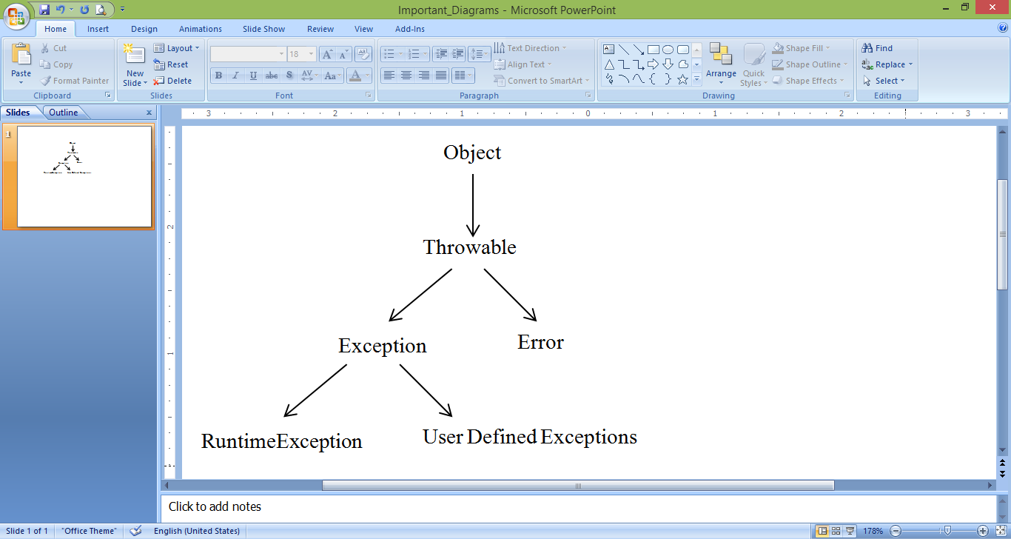
Exception Class Hierarchy

Slide 8
Uncaught Exceptions
It is useful to see what happens when you don’t handle them
This small program includes an expression that intentionally causes a divide-by-zero error:
class Exc0 {
public static void main(String args[]) {
int d = 0;
int a = 42 / d;
}
}

Slide 9
Uncaught Exceptions
Here is the exception generated when this example is executed:
java.lang.ArithmeticException: / by zero
at Exc0.main(Exc0.java:4)
The type of exception thrown is a subclass of Exception called ArithmeticException, which more specifically describes what type of error happened
The program will terminate abnormally as the exception is generated

Slide 10
Uncaught Exceptions
Another Example:
class Exc1 {
static void subroutine() {
int d = 0;
int a = 10 / d;
}
public static void main(String args[]) {
Exc1.subroutine();
}
}

Slide 11
Uncaught Exceptions
Outcome:
java.lang.ArithmeticException: / by zero
at Exc1.subroutine(Exc1.java:4)
at Exc1.main(Exc1.java:7)

Slide 12
2.
Handling Exceptions Using try and catch clauses

Slide 13
Handling Exceptions with try....catch
Handling Exceptions gives two benefits:
Allows you to fix the error
Prevents the program from automatically terminating
Format of try …. Catch
try {
// block of code to monitor for errors
}
catch (ExceptionType exOb) {
// exception handler for ExceptionType
}

Slide 14
There must not be any executable statement between try and catch block.

Slide 15
Handling Exceptions with try....catch
class Exc2 {
public static void main(String args[]) {
int d, a;
try { // monitor a block of code.
d = 0;
a = 42 / d;
System.out.println("This will not be printed.");
} catch (ArithmeticException e) { // catch divide-by-zero error
System.out.println("Division by zero.");
}
System.out.println("After catch statement.");
} }
This program generates the following output:
Division by zero.
After catch statement.

Slide 16
Displaying Description of Exception
Throwable overrides the toString( ) method (defined by Object) so that it returns a string containing a description of the exception.
We can display this description in a println( ) statement by simply passing the exception as an argument as shown below:
catch (ArithmeticException e) {
System.out.println("Exception: " + e);
}
Output
Exception: java.lang.ArithmeticException: / by zero

Slide 17
Multiple catch clauses
To handle more than one exception, we can specify two or more catch clauses, each catching a different type of exception
When an exception is thrown, each catch statement is inspected in order, and the first one whose type matches that of the exception is executed
class MultiCatch {
public static void main(String args[]) {
try {
int a = args.length;
System.out.println("a = " + a);
int b = 42 / a;
int c[] = { 1 };
c[42] = 99;
}

Slide 18
Multiple catch clauses
catch(ArithmeticException e) {
System.out.println("Divide by 0: " + e);
} catch(ArrayIndexOutOfBoundsException e) {
System.out.println("Array index oob: " + e);
}
System.out.println("After try/catch blocks.");
} }
C:\>java MultiCatch
a = 0
Divide by 0: java.lang.ArithmeticException: / by zero
After try/catch blocks.
C:\>java MultiCatch TestArg
a = 1
Array index oob: java.lang.ArrayIndexOutOfBoundsException:42
After try/catch blocks.

Slide 19
In multiple catch statements, exception
subclasses must come before any of their superclasses. (because a superclass catch will catch exceptions of that type plus any of its subclasses. Thus, a
subclass would never be reached if it came after its superclass)
class SuperSubCatch {
public static void main(String args[]) {
try {
int a = 0;
int b = 42 / a;
} catch(Exception e) {
System.out.println(“ Generic Exception”);
}
catch(ArithmeticException e) {
System.out.println(“ Not reachable");
} } }

Slide 20
Nested try statements
The try statement can be nested (a try statement can be inside the block of another try)
class NestTry {
public static void main(String args[]) {
try {
int a = args.length;
int b = 42 / a;
System.out.println("a = " + a);
try { // nested try block
if(a==1) a = a/(a-a); // division by zero

Slide 21
Nested try statements
if(a==2) {
int c[] = { 1 };
c[42] = 99;
}
} //end of inner try
catch(ArrayIndexOutOfBoundsException e) {
System.out.println("Array index out-of-bounds: " + e);
}
} // end of outer try
catch(ArithmeticException e) {
System.out.println("Divide by 0: " + e);
}
}
}

Slide 22
Nested try statements
Outcome:
C:\>java NestTry
Divide by 0: java.lang.ArithmeticException: / by zero
C:\>java NestTry One
a = 1
Divide by 0: java.lang.ArithmeticException: / by zero
C:\>java NestTry One Two
a = 2
Array index out-of-bounds:
java.lang.ArrayIndexOutOfBoundsException:42

Slide 23
3.
throw statement

Slide 24
throw statement
It is possible for your program to throw an exception explicitly, using the throw statement
The general form of throw is shown here:
throw ThrowableInstance;
ThrowableInstance must be an object of type Throwable or a subclass of Throwable.
Primitive types as well as non-Throwable classes, such as String and Object, cannot be used as exceptions

Slide 25
throw statement
class ThrowDemo {
static void demoproc() {
try {
throw new NullPointerException("demo");
} catch(NullPointerException e) {
System.out.println("Caught inside demoproc.");
throw e; // rethrow the exception
} }
public static void main(String args[]) {
try {
demoproc();
} catch(NullPointerException e) {
System.out.println("Recaught: " + e);
} } }
Caught inside demoproc.
Recaught: java.lang.NullPointerException: demo

Slide 26
4.
throws statement

Slide 27
throws statement
If a method is capable of causing an exception that it does not handle, it must specify this behavior so that callers of the method can guard themselves against that exception
It is being achieved through throws clause in the method’s declaration
A throws clause lists the types of exceptions that a method might throw
type method-name(parameter-list) throws exception-list
{
// body of method
}

Slide 28
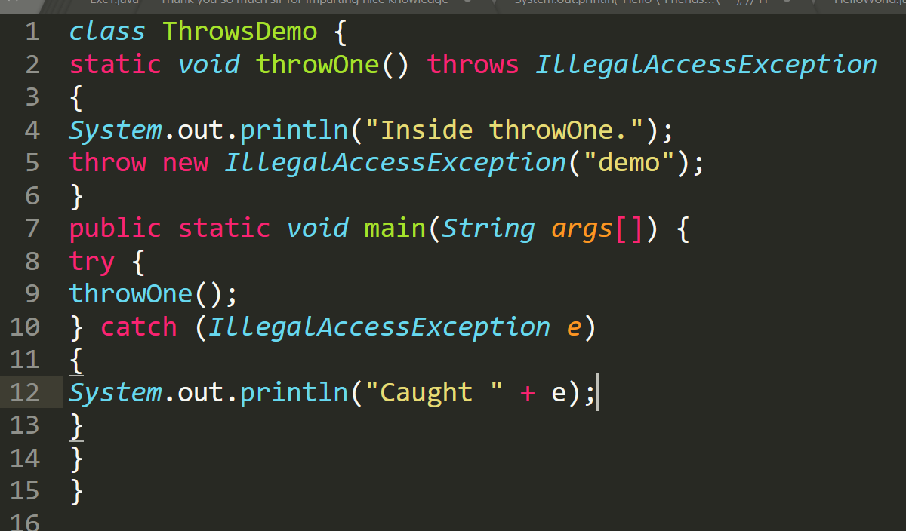
throws statement
inside throwOne
caught java.lang.IllegalAccessException: demo

Slide 29
throws clause is not compulsory for exceptions of type Error or RuntimeException, or any of their subclasses
All other exceptions that a method can throw must be declared in the throws clause. If they are not, a compile-time error will result

Slide 30
4.
Exception Types

Slide 31
Types of Exceptions
Java’s most general exceptions are subclasses of the standard type RuntimeException
These are called unchecked exceptions because the compiler does not check to see if a method handles or throws these exceptions
These exceptions need not be included in any method’s throws list.
Examples:
ArithmeticException
ArrayIndexOutOfBoundsException
NullPointerException
NumberFormatException , etc.

Slide 32
Types of Exceptions
Those exceptions that must be included in a method’s throws list (if that method can generate one of these exceptions and does not handle it itself), are called checked exceptions.
Examples:
ClassNotFoundException
IOException
NoSuchMethodException
InterruptedException,etc.

Slide 33
5.
finally keyword

Slide 34
finally keyword
When exceptions are thrown, the method returns prematurely. This could be a problem in some methods
For example, if a method opens a file upon entry and closes it upon exit then the file closing operation should not to be bypassed by the exception-handling mechanism
The finally keyword is designed to address this contingency
finally creates a block of code that will be executed after a try/catch block has completed and before the code following the try/catch block
The finally block will execute whether or not an exception is thrown

Slide 35
finally keyword
class FinallyDemo {
// Through an exception out of the method.
static void procA() {
try {
System.out.println("inside procA");
throw new RuntimeException("demo");
} finally {
System.out.println("procA's finally");
}
}

Slide 36
finally keyword
// Return from within a try block.
static void procB() {
try {
System.out.println("inside procB");
return;
} finally {
System.out.println("procB's finally");
}
}

Slide 37
finally keyword
// Execute a try block normally.
static void procC() {
try {
System.out.println("inside procC");
}
finally {
System.out.println("procC's finally");
}
}

Slide 38
finally keyword
// public static void main(String args[]) {
try {
procA();
} catch (Exception e) {
System.out.println("Exception caught");
}
procB();
procC();
}
}

Slide 39
finally keyword
Result:
inside procA
procA’s finally
Exception caught
inside procB
procB’s finally
inside procC
procC’s finally

Slide 40
6.
User Defined Exception Class

Slide 41
Creating own Exception Class
To create our own exception class, we have to extend the Exception class
The Exception class defines some constructors, two are listed below:
Exception( ) // default
Exception(String msg) // msg is exception description
We have to override toString() method (member of Object class) to customize the description of generated exception

Slide 42
Creating own Exception Class
class MyException extends Exception {
private int detail;
MyException(int a) {
detail = a;
}
public String toString() {
return "MyException[" + detail + "]";
}
}

Slide 43
Creating own Exception Class
class ExceptionDemo {
static void compute(int a) throws MyException {
System.out.println("Called compute(" + a + ")");
if(a > 10)
throw new MyException(a);
System.out.println("Normal exit");
}

Slide 44
Creating own Exception Class
public static void main(String args[]) {
try {
compute(1);
compute(20);
} catch (MyException e) {
System.out.println("Caught " + e);
}
}
}

Slide 45
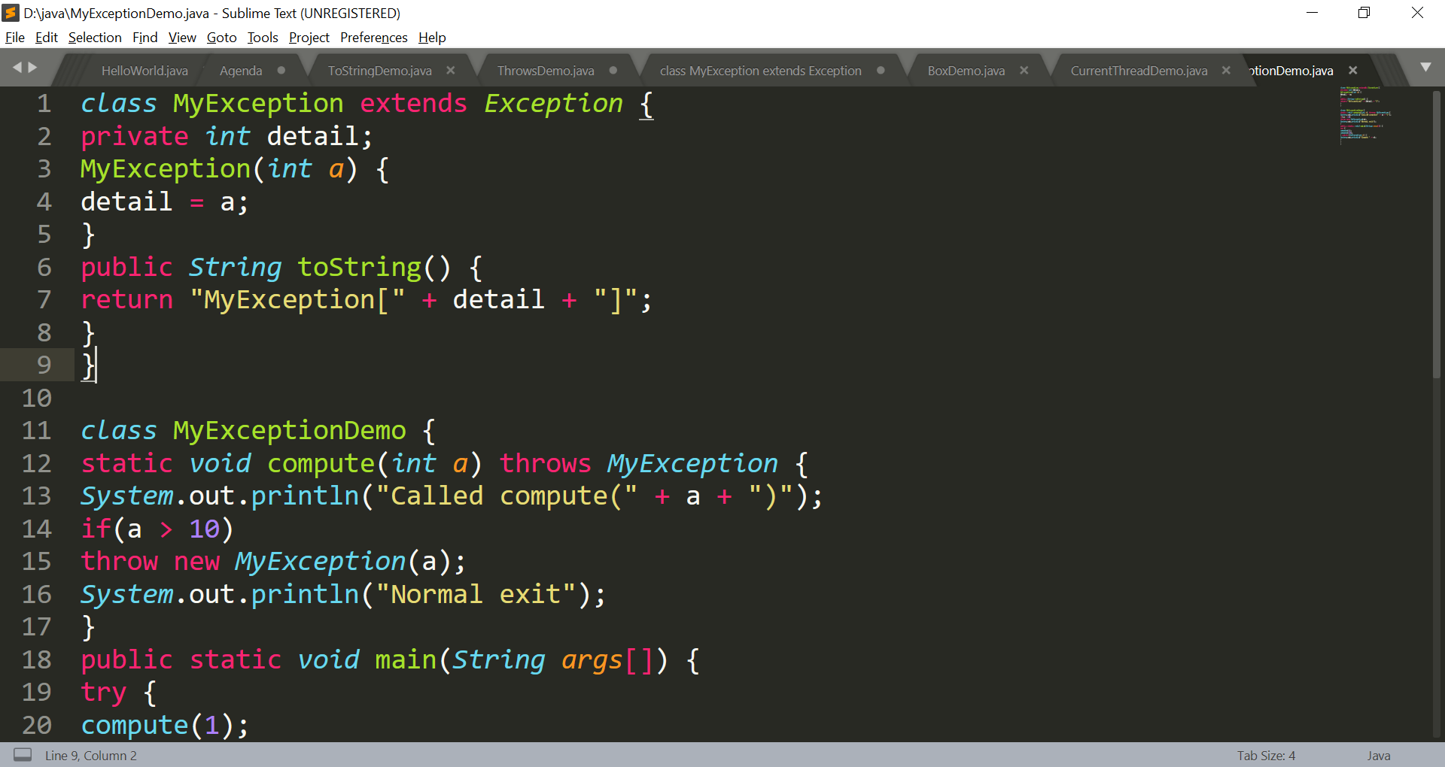
Creating own Exception Class

Slide 46
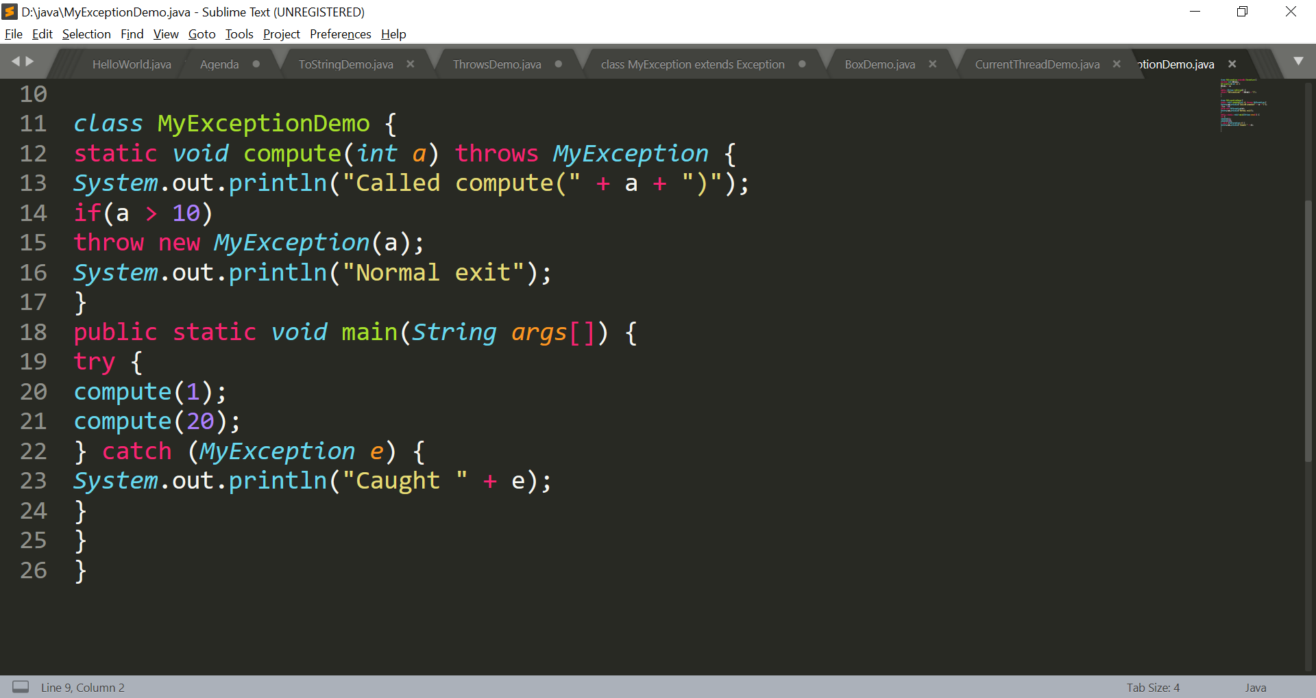
Creating own Exception Class

Slide 47
Creating own Exception Class
Output:
Called compute(1)
Normal exit
Called compute(20)
Caught MyException[20]

Slide 48
Creating own Exception Class
Problem Statement:
To find out sqrt / log
Employee program => experience (years)
(lower limit = 0 upper limit = 40 ) 41

Slide 49
Thanks!
Any questions?
You can find me at:
manish_ratilal2002@yahoo.com

Slide 50
Credits
My degree Professor Mr. D.G. Thakor who taught me Java
Java The Complete Reference
Tutorials and Forums available on Internet

